Slide 1
Mark 10 : 17-31

Slide 2
¹⁷ And as he was setting out on his journey, a man ran up and knelt before him and asked him, “Good Teacher, what must I do to inherit eternal life?” ¹⁸ And Jesus said to him, “Why do you call me good? No one is good except God alone. ¹⁹ You know the commandments: ‘Do not murder, Do not commit adultery, Do not steal, Do not bear false witness, Do not defraud, Honour your father and mother.’ ” ²⁰ And he said to him, “Teacher, all these I have kept from my youth.” ²¹ And Jesus, looking at him, loved him, and said to him, “You lack one thing: go, sell all that you have and give to the poor, and you will have treasure in heaven; and come, follow me.” ²² Disheartened by the saying, he went away sorrowful, for he had great possessions.

Slide 3
²³ And Jesus looked around and said to his disciples, “How difficult it will be for those who have wealth to enter the kingdom of God!” ²⁴ And the disciples were amazed at his words. But Jesus said to them again, “Children, how difficult it is to enter the kingdom of God! ²⁵ It is easier for a camel to go through the eye of a needle than for a rich person to enter the kingdom of God.” ²⁶ And they were exceedingly astonished, and said to him, “Then who can be saved?” ²⁷ Jesus looked at them and said, “With man it is impossible, but not with God. For all things are possible with God.”

Slide 4
²⁸ Peter began to say to him, “See, we have left everything and followed you.” ²⁹ Jesus said, “Truly, I say to you, there is no one who has left house or brothers or sisters or mother or father or children or lands, for my sake and for the gospel, ³⁰ who will not receive a hundredfold now in this time, houses and brothers and sisters and mothers and children and lands, with persecutions, and in the age to come eternal life. ³¹ But many who are first will be last, and the last first.”

Slide 5
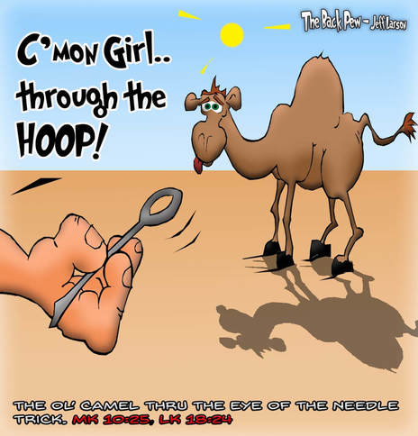

Slide 6
The Benefits of Discipleship
A worldly perspective only understands worldly blessings
But Jesus gives His disciples Spiritual blessings in this life and in the life to come
²⁹ Jesus said, “Truly, I say to you, there is no one who has left house or brothers or sisters or mother or father or children or lands, for my sake and for the gospel, ³⁰ who will not receive a hundredfold now in this time, houses and brothers and sisters and mothers and children and lands, with persecutions, and in the age to come eternal life.
Provision; Fellowship; Community; Family; Connection / Belonging; Salvation
1. Blessing begins with Sacrifice
2. Sacrifice for the sake of Jesus & the Gospel
What we give up to follow; obey; serve
Because we love Jesus & because we love others
As we serve, and to support others as they serve
3. Blessings are shared (not usually possessions we keep for ourselves)
Sometimes we’re the ones receiving the blessing
Sometimes we’re the ones who share the blessing
The Lord blesses us, so we can share what we have.

Slide 7
The Benefits of Discipleship
A worldly perspective only understands worldly blessings
But Jesus gives His disciples Spiritual blessings in this life and in the life to come
Provision; Fellowship; Community; Family; Connection / Belonging; Salvation
1. Blessing begins with Sacrifice
2. Sacrifice for the sake of Jesus & the Gospel
What we give up to follow; obey; serve
Because we love Jesus & because we love others
As we serve, and to support others as they serve
3. Blessings are shared (not usually possessions we keep for ourselves)
Sometimes we’re the ones receiving the blessing
Sometimes we’re the ones who share the blessing
The Lord blesses us, so we can share what we have.
Even our lives are to be shared – Our Christian family gives a sense of community; belonging; family
4. With blessings, come persecutions in this life
5. Eternal blessings

